Slide 1

A Pantry To Table Recipe App

Slide 2
Who am I?
John Buczkowski
CoffeeStain Consulting
Boston, MA
Senior Software Consultant
Over 40 Years of Industry Experience
jxb@tiac.net
617-435-8115
www.linkedin.com/in/johnbuczkowski

Slide 3
KitchClick – What is it?

Slide 4
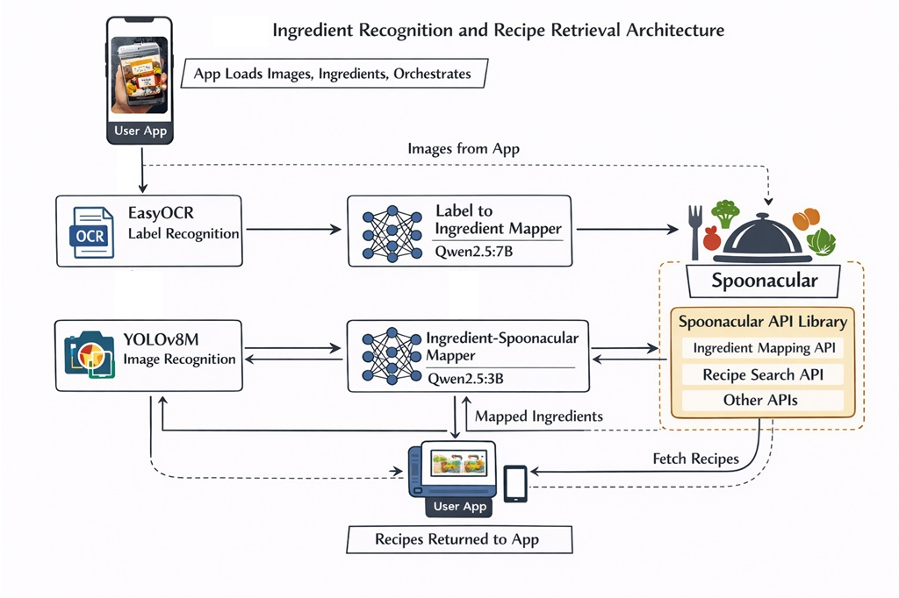
Architectural Overview

Slide 5
Architectural Details

Slide 6
Models
YoloV8M – 1 stop shopping. automatically generates plots,
EasyOCR
qwen2.5:14b
qwen2.5:7b
Hardware:
GPU: NVIDIA Blackwell-architecture GPU.
VRAM: 28GB.
Technology: Lovelace (RTX 40-series).

Slide 7
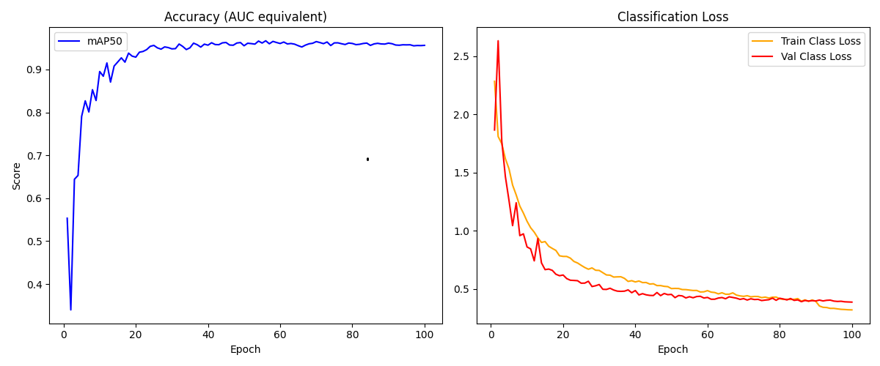
Model Performance

Slide 8
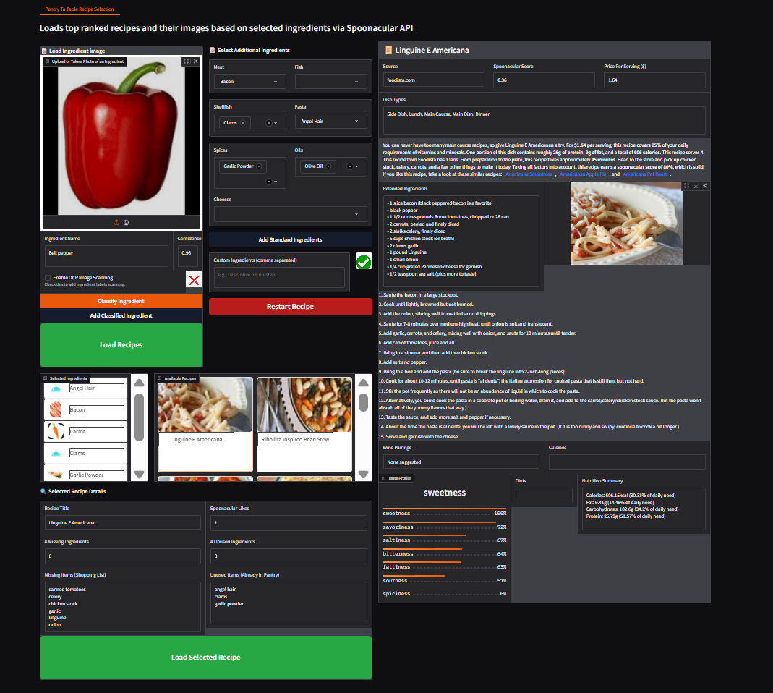
The KitchClick Application

Slide 9
Image Data Sources
Data Sources for Unlabeled Ingredient Images
vegetables/vegetables-el4g6 version:1
sqdq/fruits-and-vegetables-qlxmk version:1
zzigmug/fruits-and-vegetables-knetf version:1
yaman-e/food-ingredients-detection-qfit7 version:48
lhu-dqyuc/fruits-and-vegetables-mfsau version:1
college-74jj5/freshness-fruits-and-vegetables version:1
cse299/fruit-and-vegetable version:1
project-6000-agriculture/fruits-and-vegetables-17y0t version:1
michael-ringer/freiburg-groceries version:10
nutrilens-qvsz6/food-ingredients-detection-nxe34 version:3
test-on9hk/vegetables-kacga version:5
food-recipe-ingredient-images-0gnku/food-ingredients-dataset version:4
Data Sources for Unlabeled Ingredient Images
https://world.openfoodfacts.org/cgi/search.pl (Food Products Database)

Slide 10
Challenges
Finding quality images for image scanning
Mapping labels to consistent ids across varied image sources

Slide 11
Moving Forward – The Next Steps
Moving all the model and business logic into webservices
Building a cleaner/simpler UI
Building UI out on multiple platforms – web, mobile, Android, iPhone
YoloV8 increase the number of ingredient types currently trained on only 12 classes
Continue investigating dependable image sources for model training
Removing pre-canned selection of ingredients and relying more on ingredient classification
Optimization
Occusion Training
How to handle niche/specialty/unknown items

Slide 13
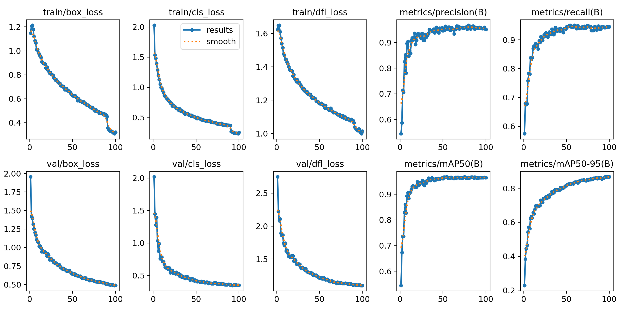

Slide 14
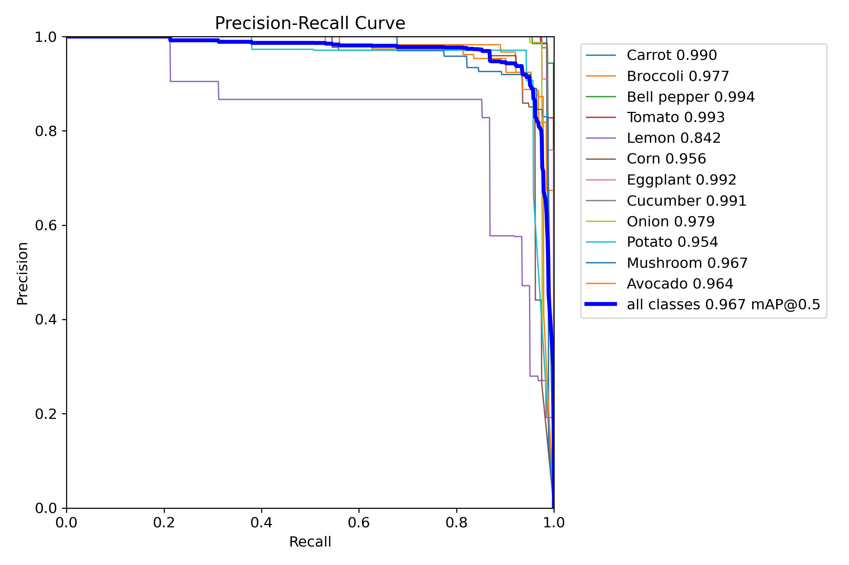

Slide 15
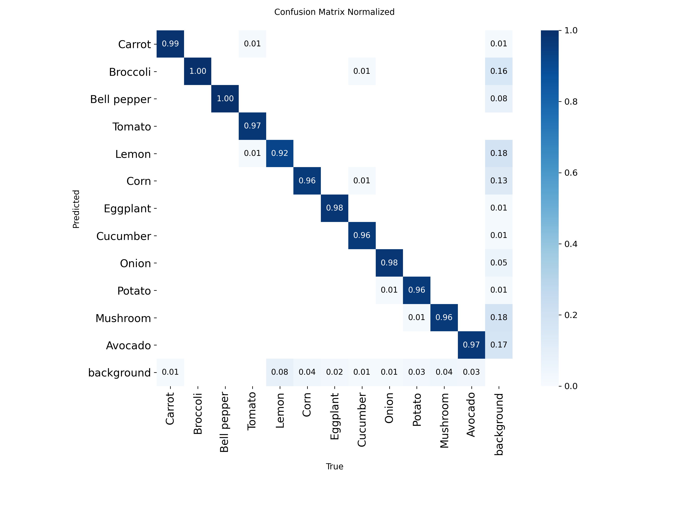

Slide 16
Data.yaml – Ingredient Label to ID Mapping
names:
0: Carrot
1: Broccoli
2: Bell pepper
3: Tomato
4: Lemon
5: Corn
6: Eggplant
7: Cucumber
8: Onion
9: Potato
10: Mushroom
11: Avocado

Slide 17
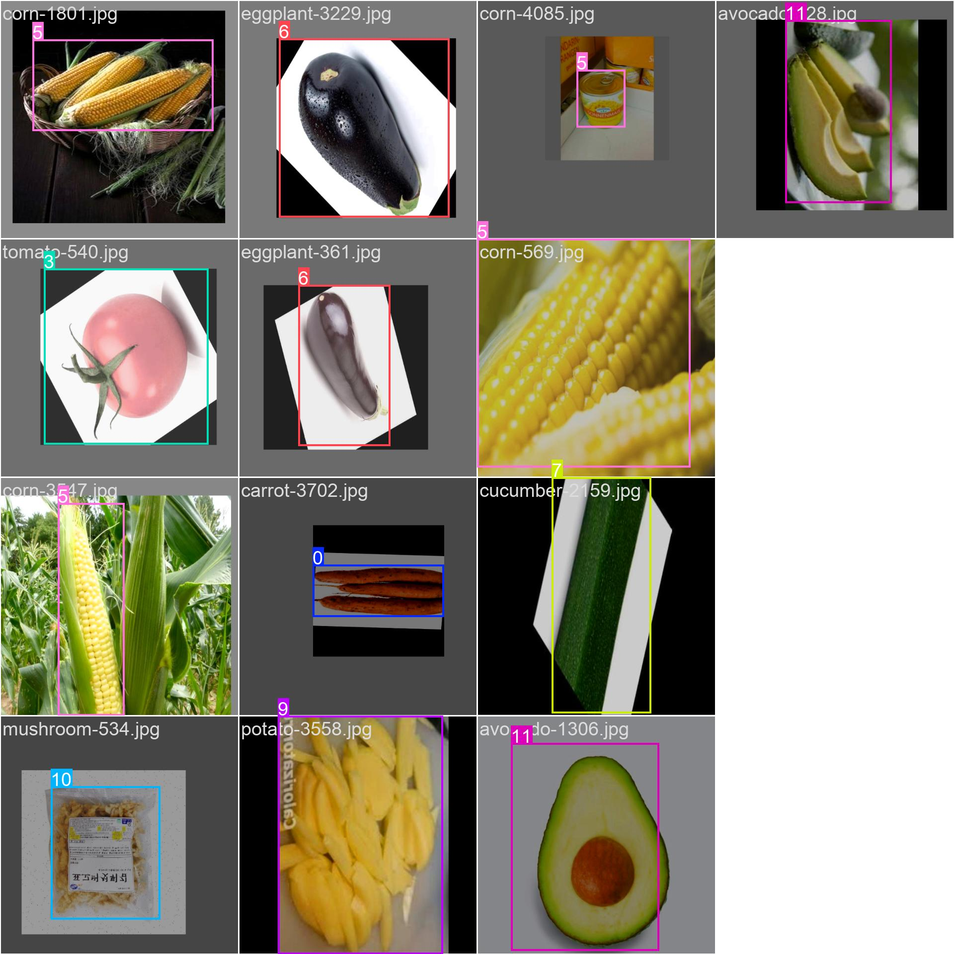
Image Classifications Examples

